Slide 1

Welcome to our first Engineering Camp!
Notes:
Say our hellos

Slide 2
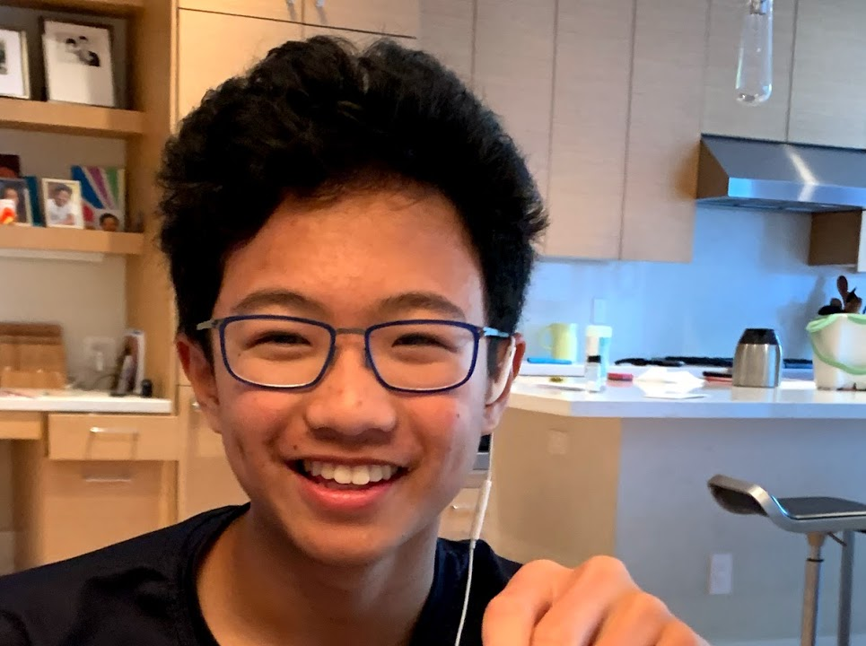
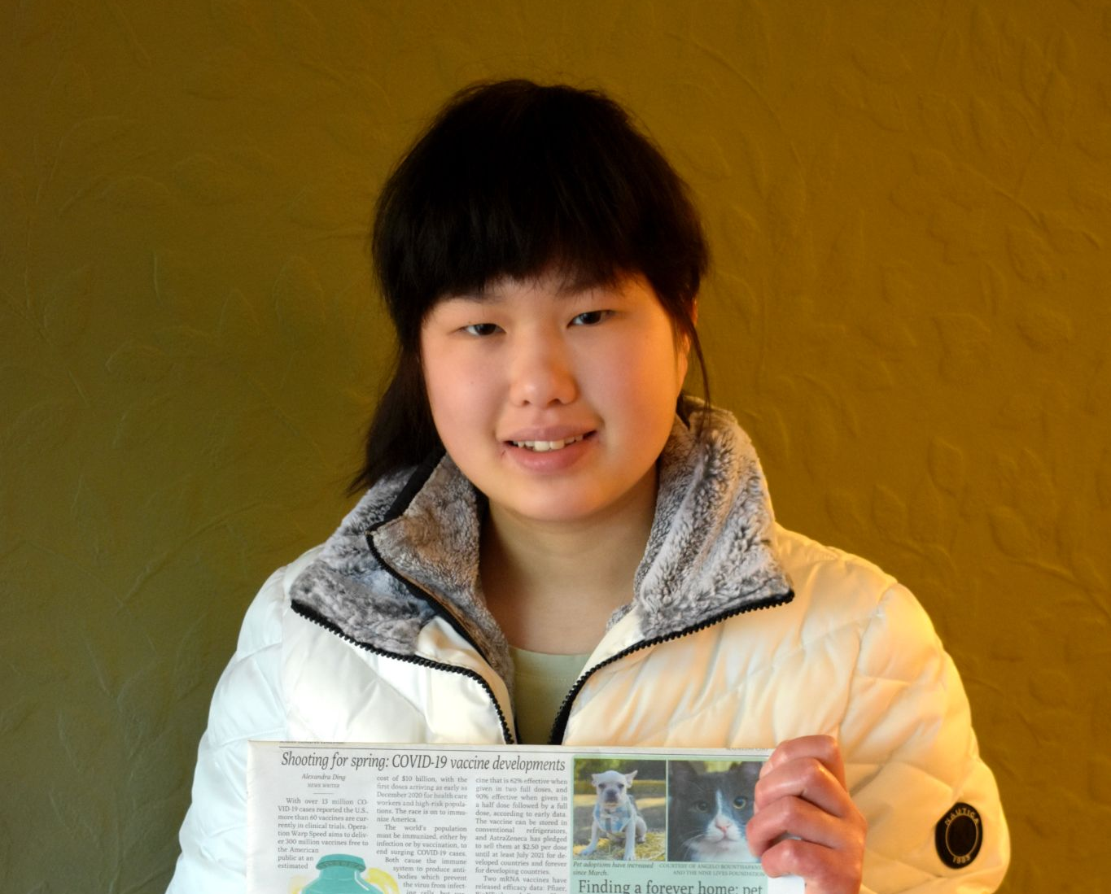
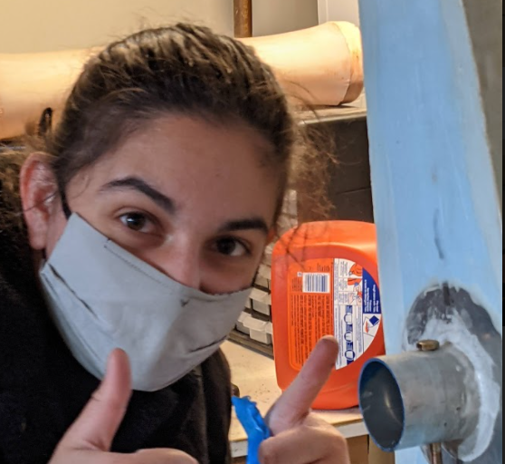
Meet the team!
Kyle - Sophomore Urban (he/they)
Alex - Sophomore Aragon (she/they)
Maya - Senior Aragon (she/they)

Slide 3
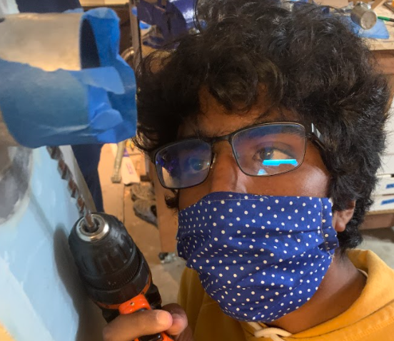
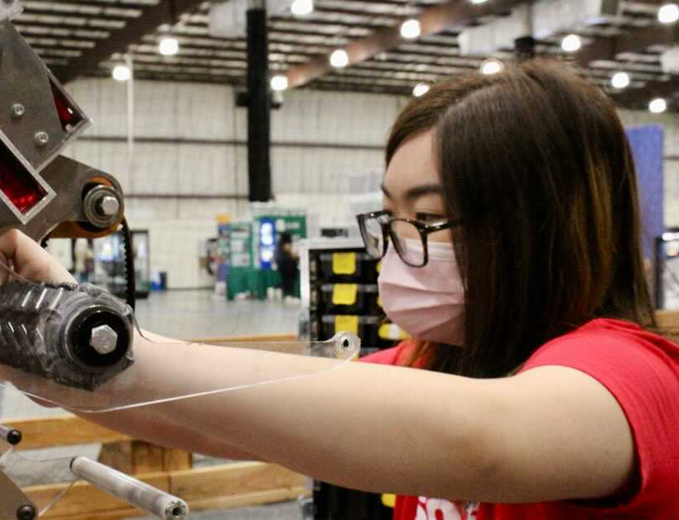
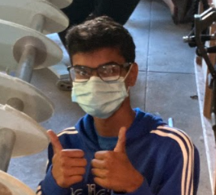
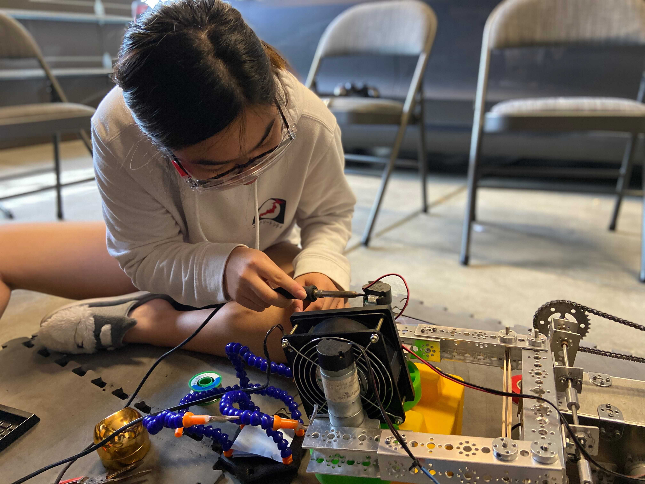
Meet the team!
Agastya - Sophomore Aragon (he/they)
Jasmine - Junior BHS (she/her)
Harish - Junior Aragon (he/him)

Slide 4
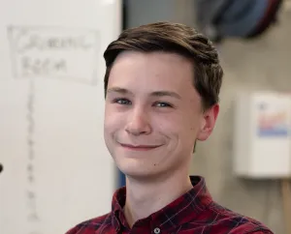
Meet the team!
Keaton - Senior Lick (he/him)

Slide 5
Agenda
10 mins: Who are we?
15 mins: Goals & Curriculum for this course
10 mins: Requirements + Logistics
5 mins: Website + Resources
10 mins: Create Onshape account
10 mins: Questions/Comments/Concerns?
Feel free to ask them in the chat/unmute whenever!
Notes:
Kyle

Slide 6
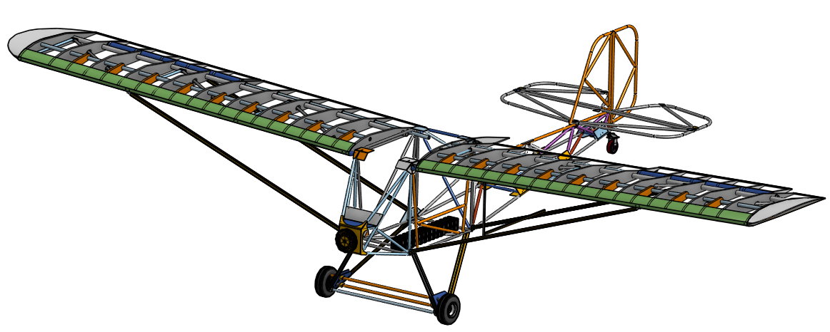
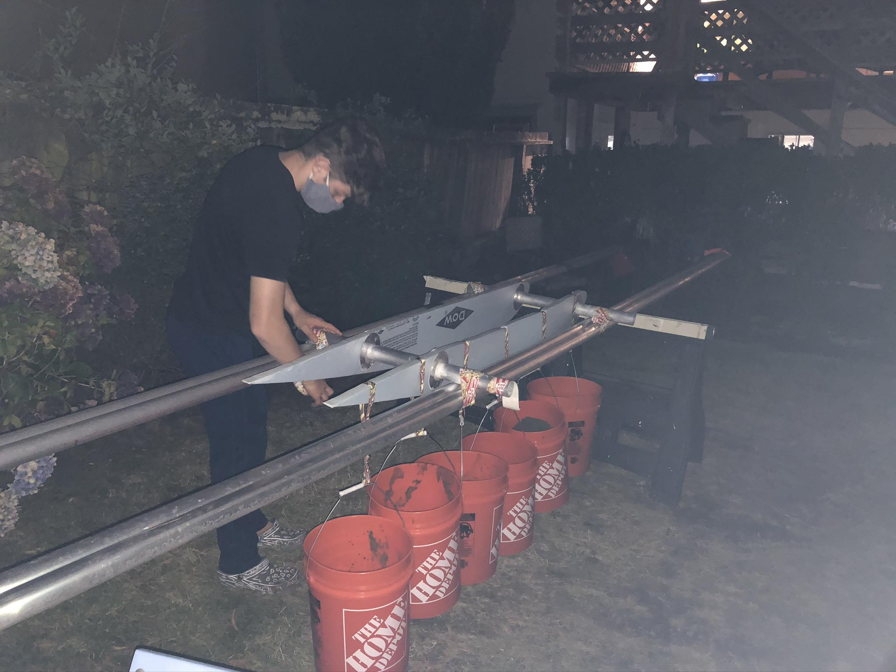
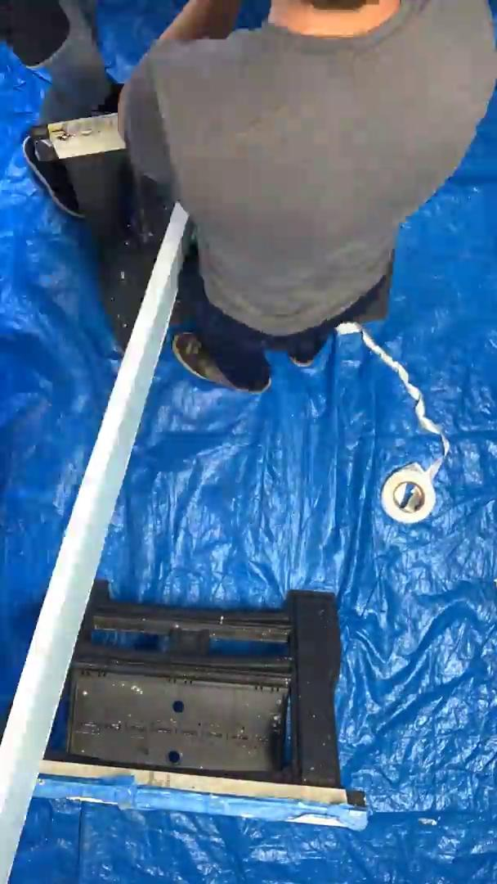
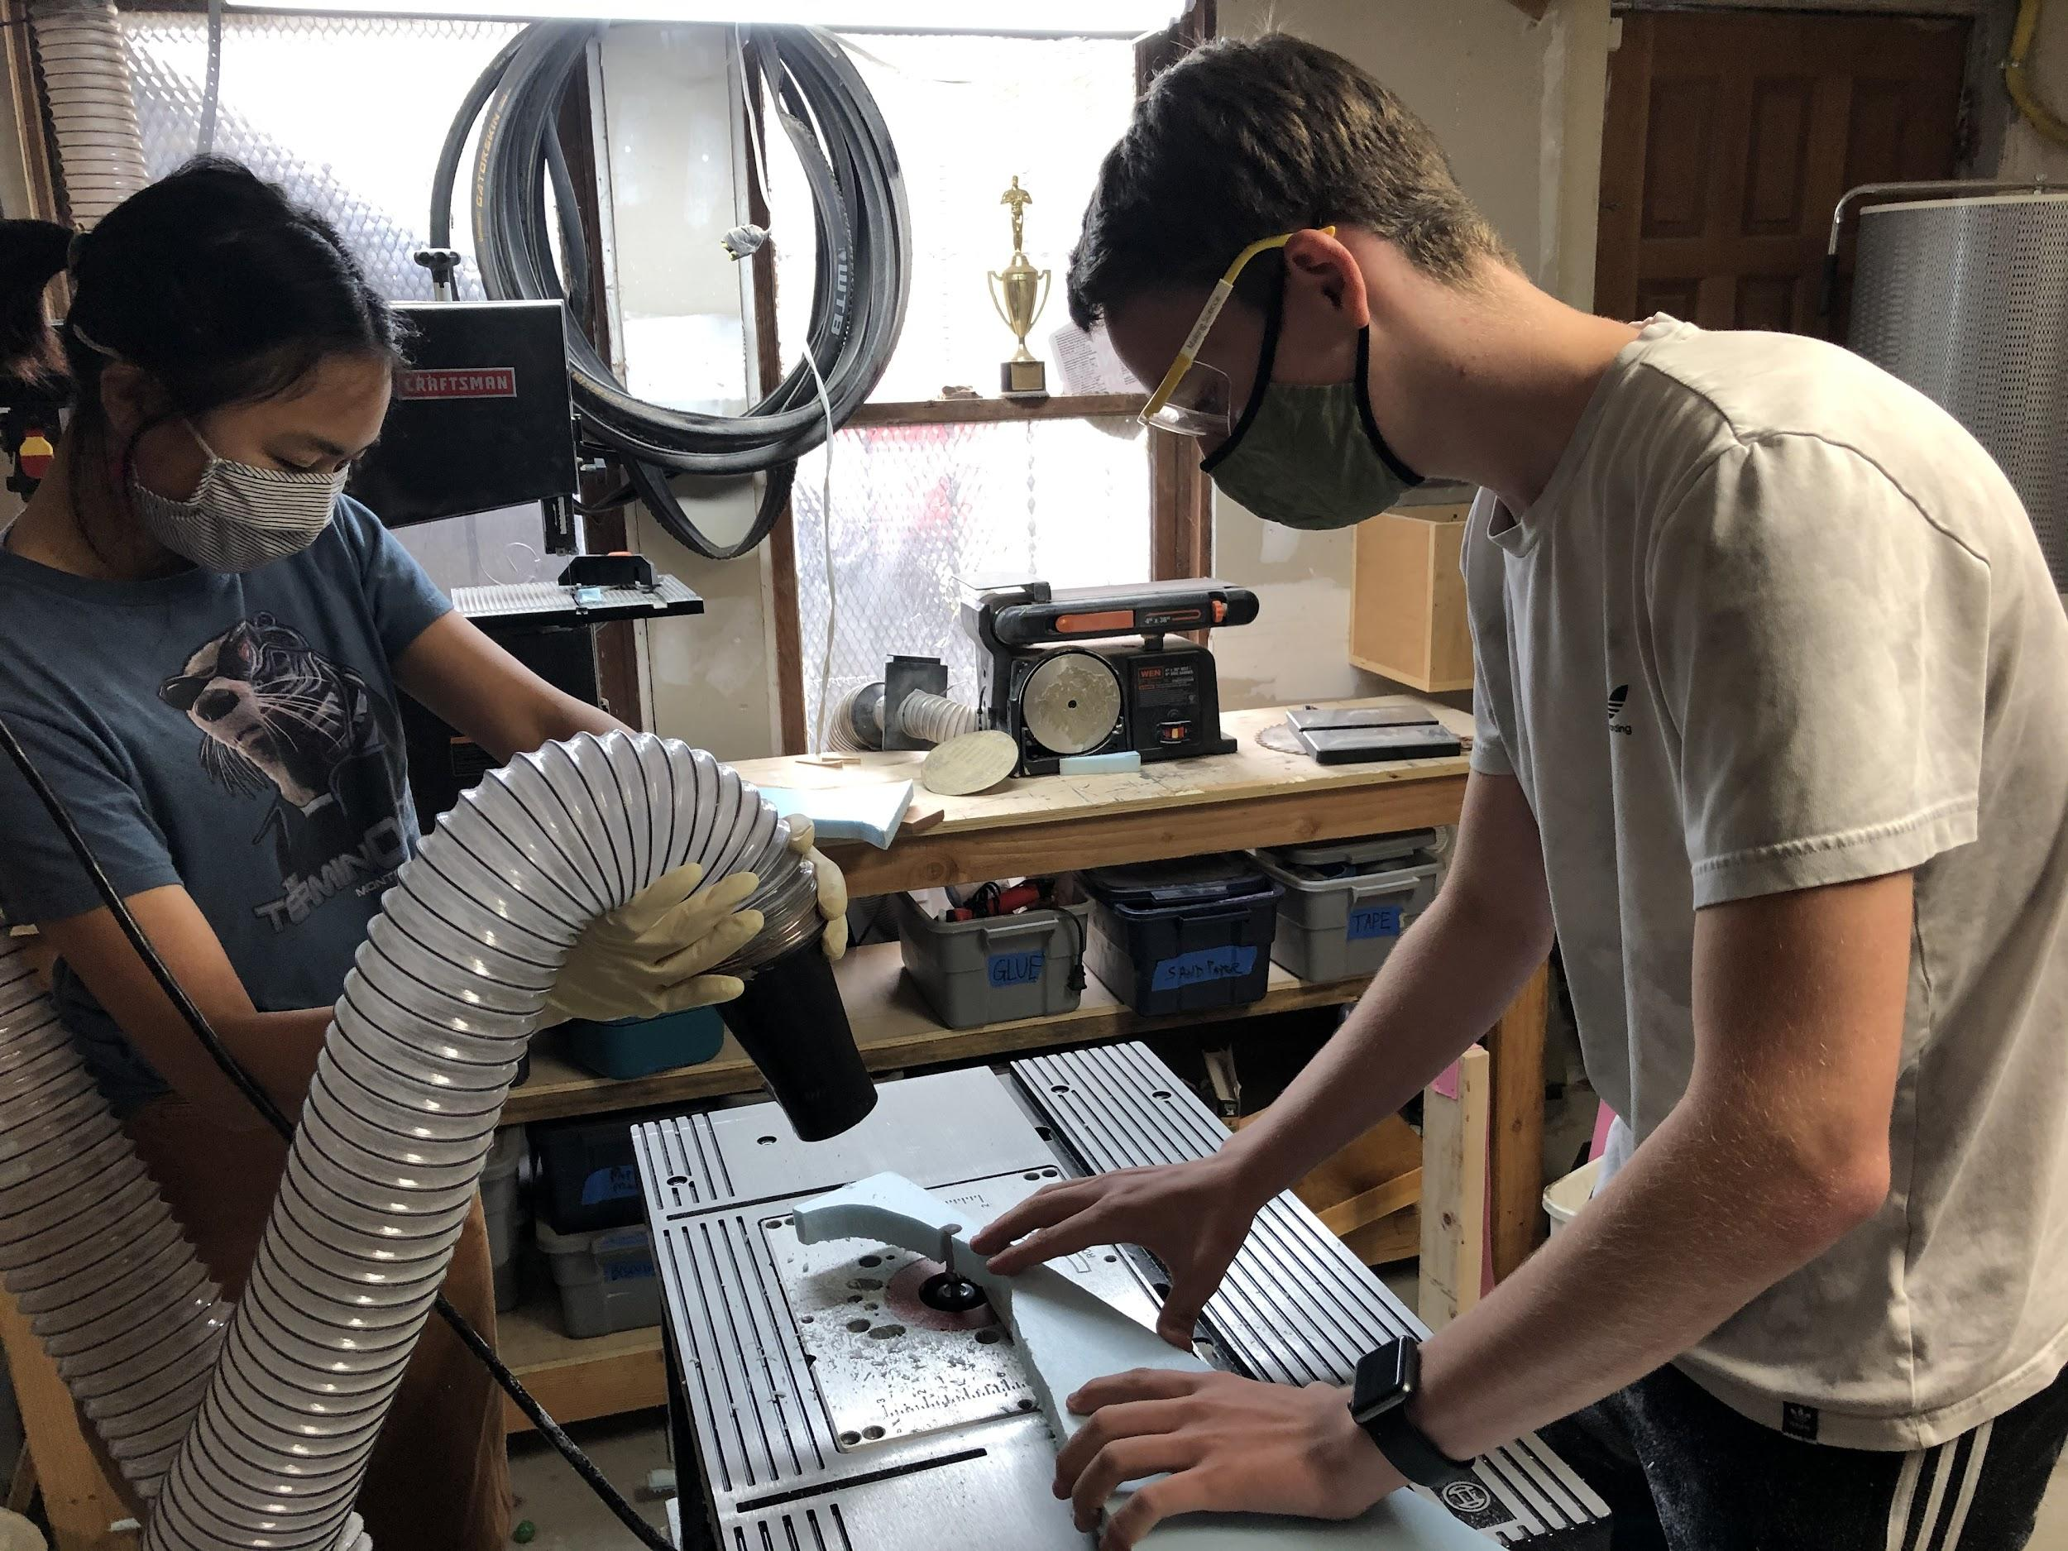
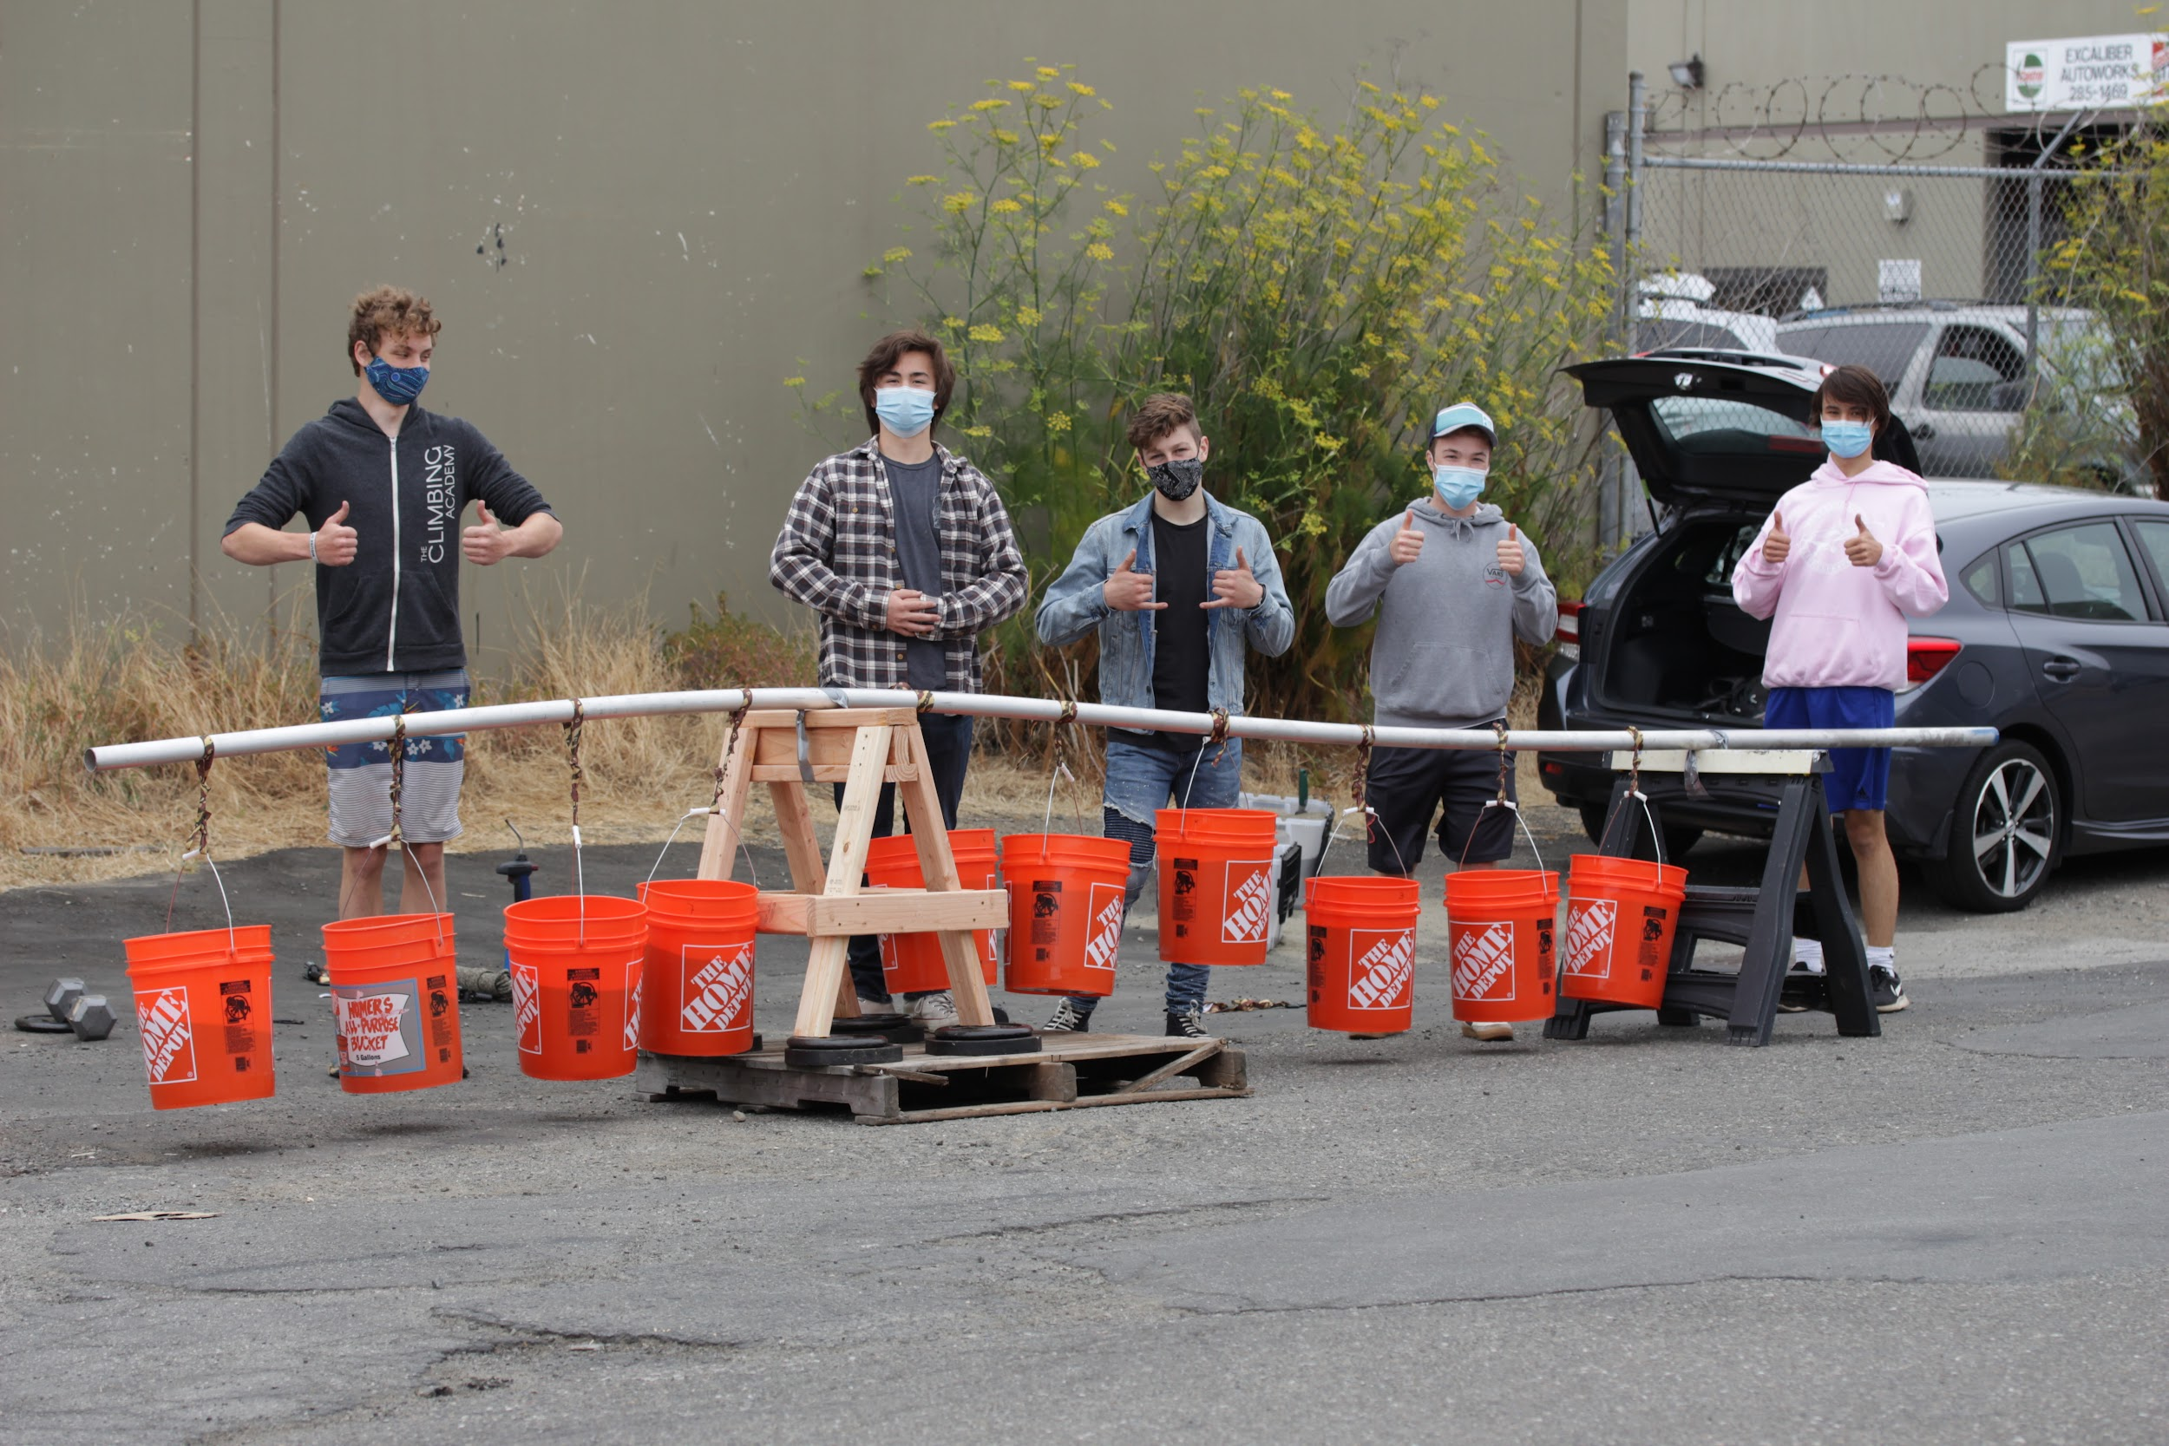
Who are we?
Notes:
Kyle
Talk about nonprofit organization oriented towards encouraging people towards stem! Our current project is on building an ultralight airplane!

Slide 7
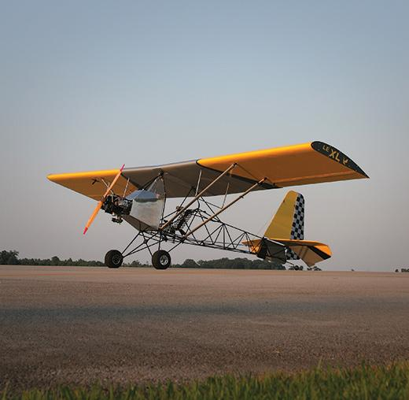
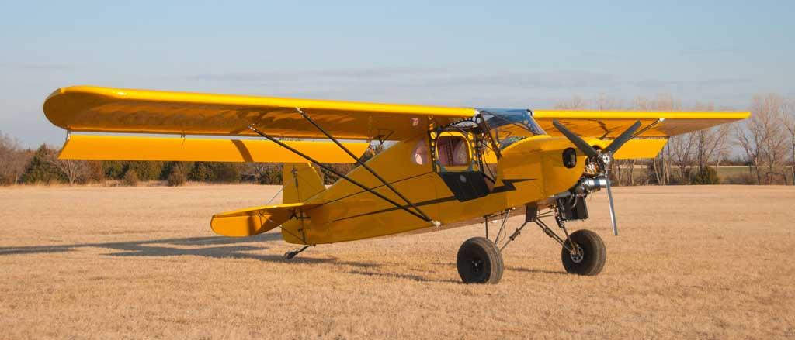
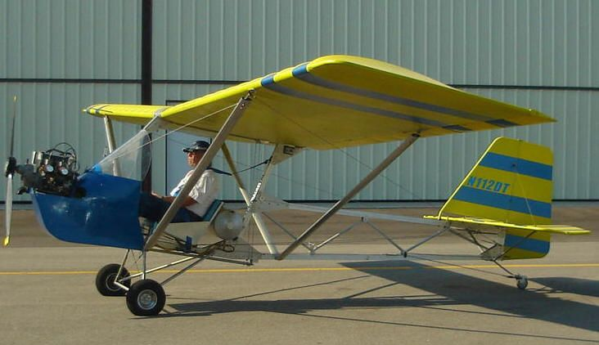
What is an Ultralight Airplane?
Weighs under 254 pounds
Has a top speed of 63 mph, about the speed you go on the highway
Only one person can fly in it
You can build it at home!
Notes:
Agastya: we are using an ultralight airplane as a vessel to teach kids about various STEAM related subjects. An ultralight aeroplane is essentially a small, light, and slow aeroplane that one can build at home, making aviation far more accessible than it has been in the past.

Slide 8
30 members
Open source
Grades 9 - 12
Free and accessible
California Wide
Electric
Members from 12 Schools
Supporting alternative energy solutions
Sparking Ingenuity
Student led
Collaboration that excites
Aiding the future ultralight community
Notes:
jasmine

Slide 9
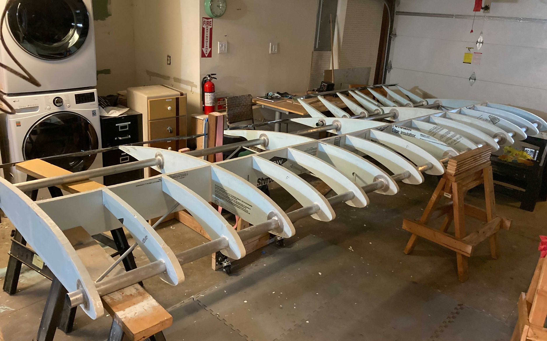
Our Mission
Created by students for students, Flight Club Aerospace inspires and empowers creative individuals to pursue their passion for aviation. We will deliver an accessible curriculum centered around aircraft design that will hold a long-lasting educational impact and provide knowledge, community, and resources for the next generation.
Notes:
Agastya: Flight Club Aerospace aims to teach children about STEAM in an accessible, fun, and hands-on manner to inspire them to pursue further education and contribute their own knowledge to whoever they can.

Slide 10
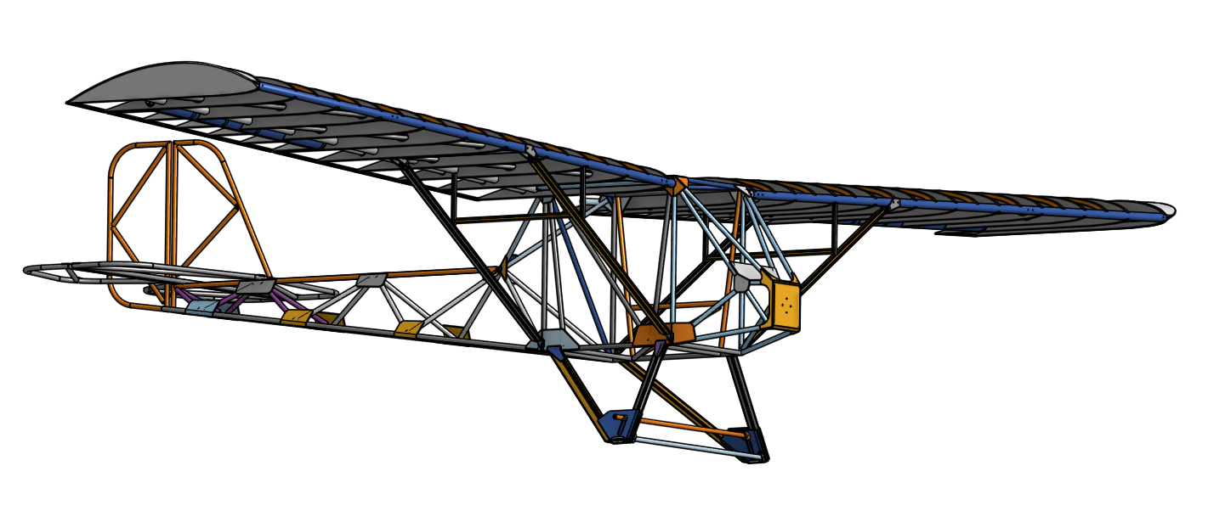
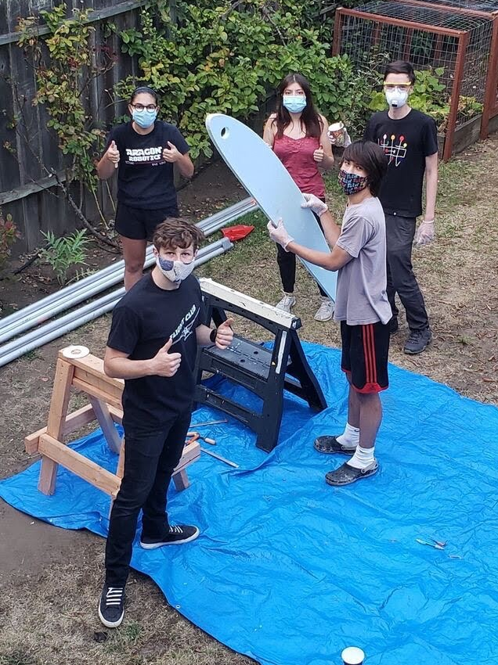
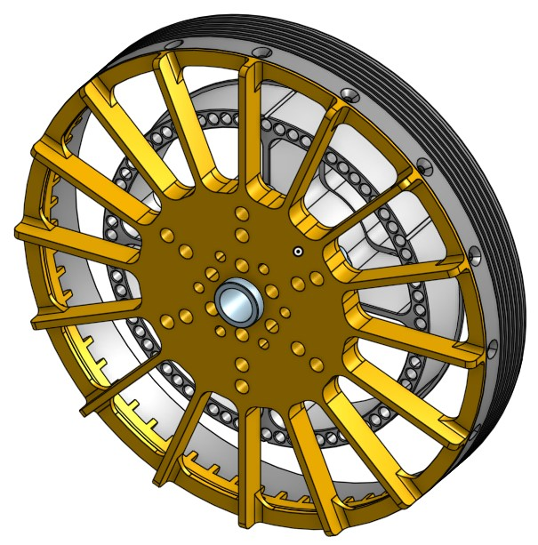
Engineers
Designers
Leaders
Artists
Mathematicians
Programmers
Community Organizers
Notes:
maya

Slide 11
Teams
Design
Electrical
Fabrication
Finance
Computer Aided Design
Research and designing the aircraft
Record process through blog posts
Powertrain optimization and design
Custom PCB design
Build the plane at our Hayward hanger
Experimentation + load testing
Grant research + writing
Manage budget
Communication with Hack+
Marketing
Outreach
Physics
Software
Graphic design
Website management
User experience design
Overall gestalt
Presentations for K-8
8-week camps with middle school students
Community-centered
Computational fluid dynamic simulations
Truss analysis informing design
Aerodynamic loading and safety
Designing avionics and sensors
In charge of user interface
Notes:
Kyle - Talk about diversity of skill sets in engineering and design

Slide 12
Teams
Design
Electrical
Fabrication
Finance
Computer Aided Design
Research and designing the aircraft
Record process through blog posts
Powertrain optimization and design
Custom PCB design
Build the plane at our Hayward hanger
Experimentation + load testing
Grant research + writing
Manage budget
Communication with Hack+
Marketing
Outreach
Physics
Software
Graphic design
Website management
User experience design
Overall gestalt
Presentations for K-8
8-week camps with middle school students
Community-centered
Computational fluid dynamic simulations
Truss analysis informing design
Aerodynamic loading and safety
Designing avionics and sensors
In charge of user interface
Notes:
Kyle - Talk about diversity of skill sets in engineering and design

Slide 13
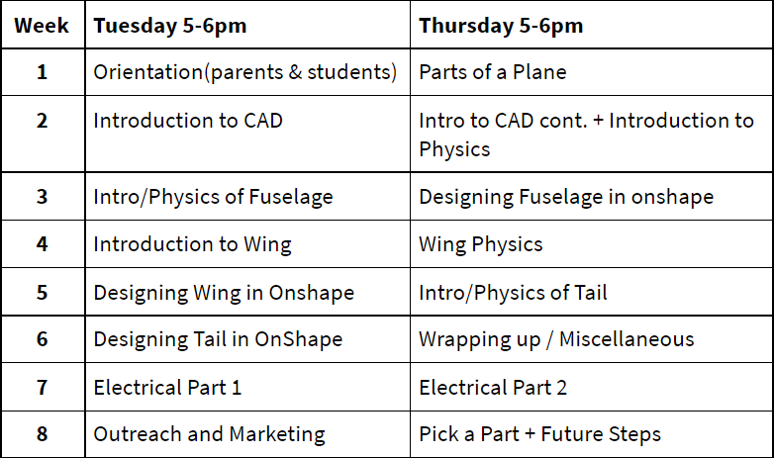
Overview of the Whole Class!
Notes:
alex
Talk about each one individually
First week is intro to the course & aerospace as a whole
Cad intro bc takes a consistent while to figure out the program, physics

Slide 14
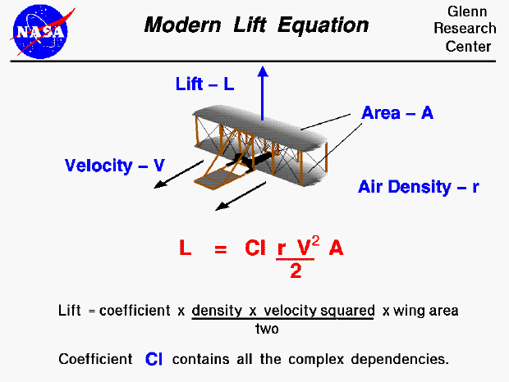
Goals for the Course: Physics
Learn the physics of a plane both conceptually & with equations
Fuselage: Forces & Moments
Why do planes fly?
Wing: Lift Equation, Drag,
Investigation of theories & assessing hypothesi
Control Systems: their purpose, how do they control the plane?
Why? Real life!
Notes:
alex
Explain some of the physics itself
Real life: explain how we use the physics we’re teaching them on our own plane
Show photo of our

Slide 15
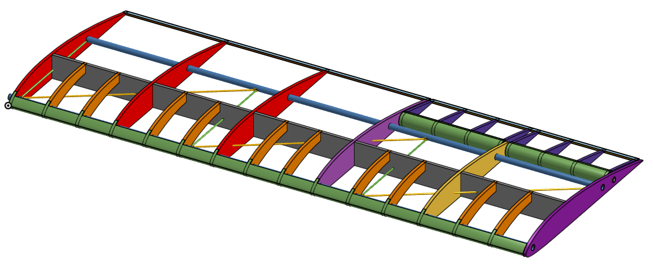
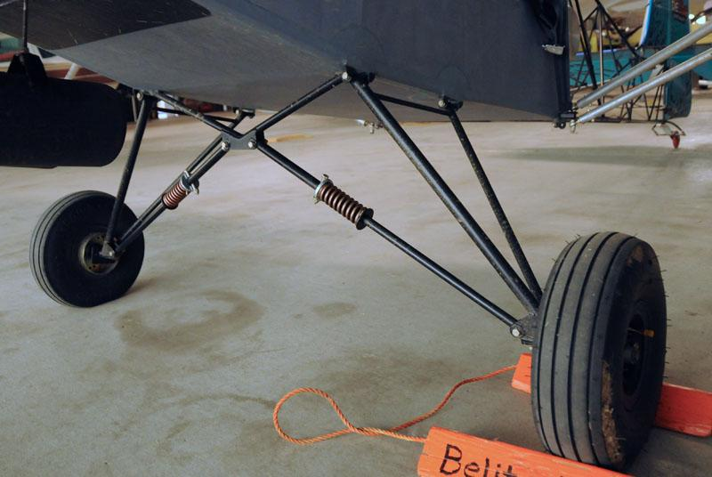
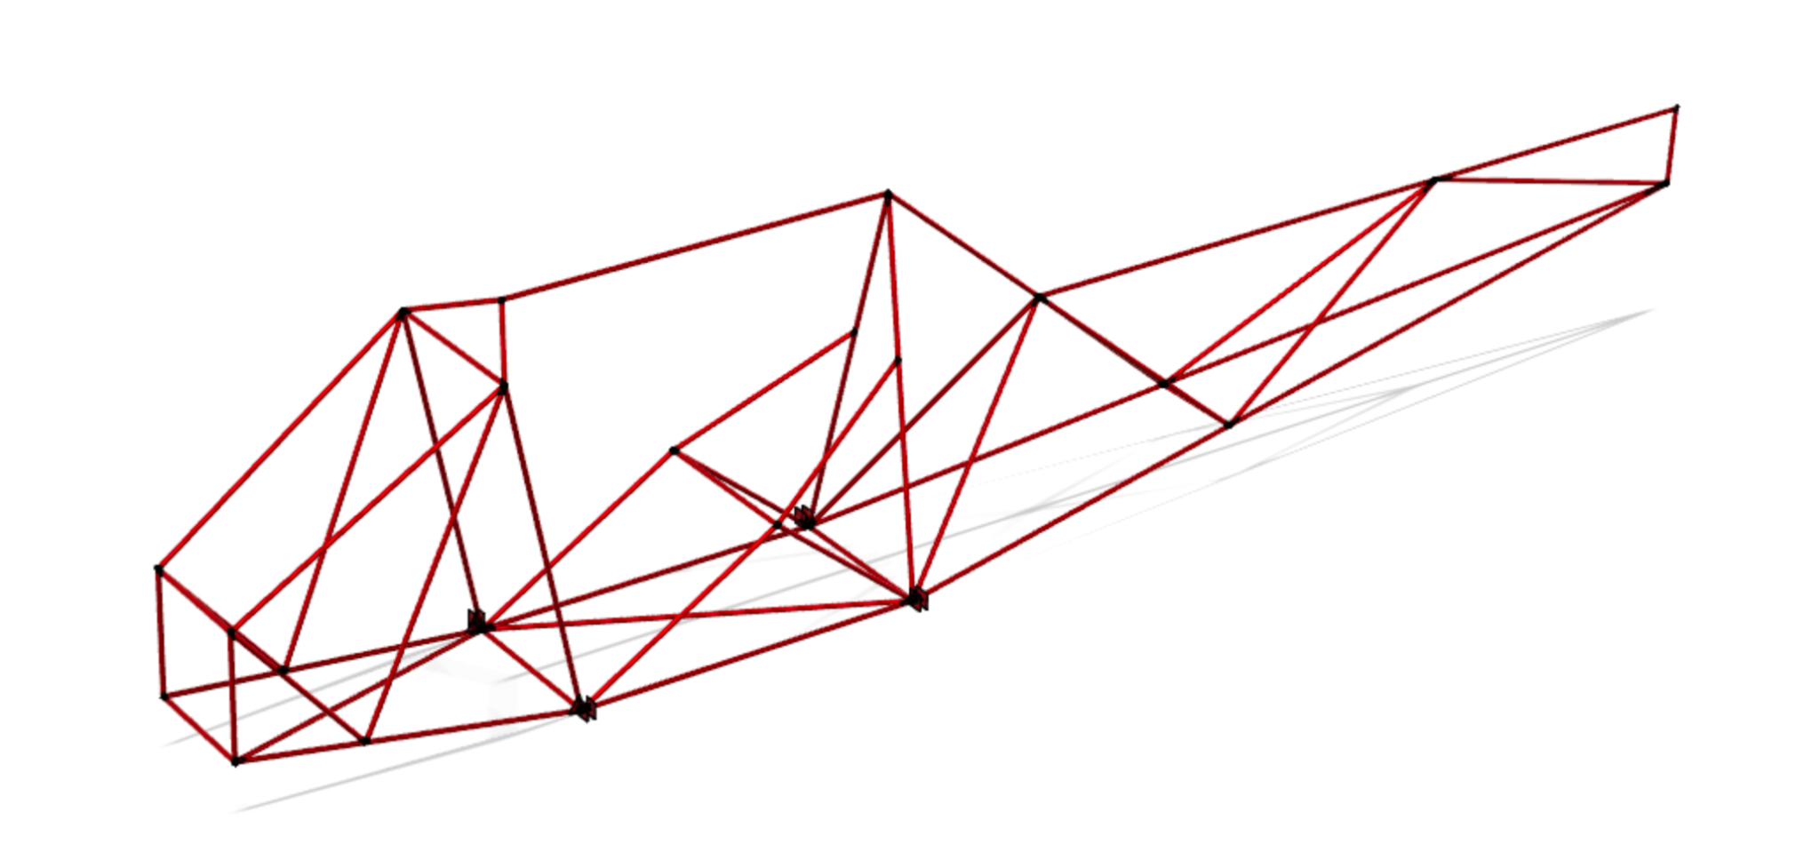
Goals for the Course: Design
Know the function of the major parts of a plane
Landing Gear
Fuselage
Wings + Aileron
Empennage
Rudder + Elevator
Why? the mechanical knowledge is universal
Notes:
jasmine

Slide 16
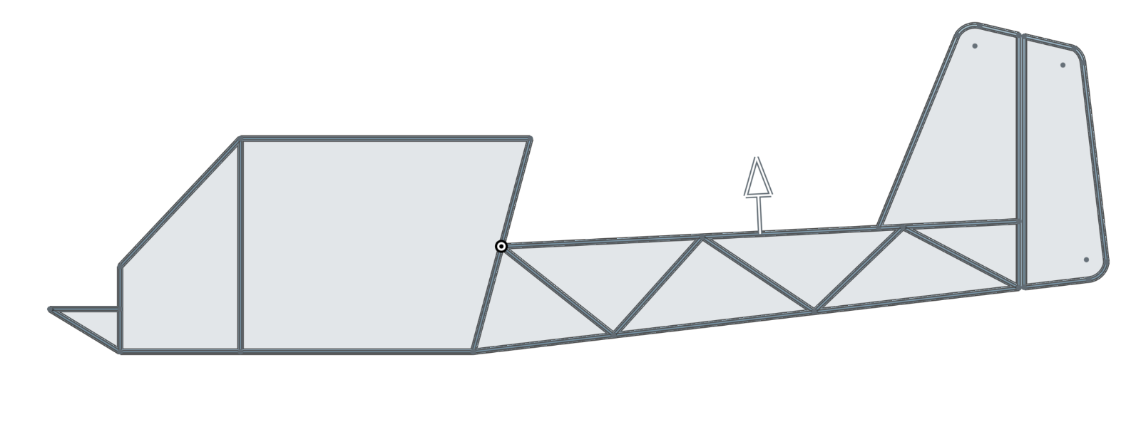
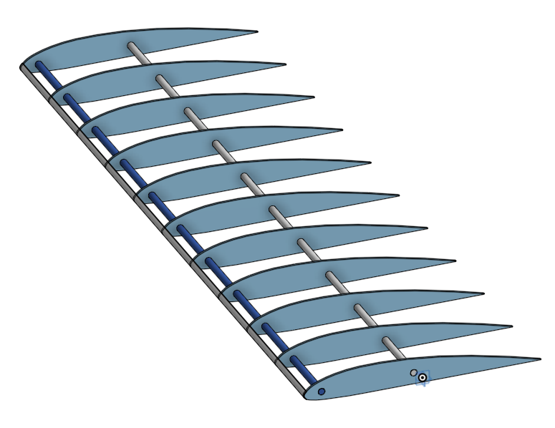
Goals for the Course: CAD
Use Onshape & design their own parts
Onshape: browser-based Computer Aided Design
Accessible for all computers
Example: Wings
Why? CAD: engineering-wide softwares that aid with conveying of ideas and design
Fusion 360 & our design
Notes:
Harish

Slide 17
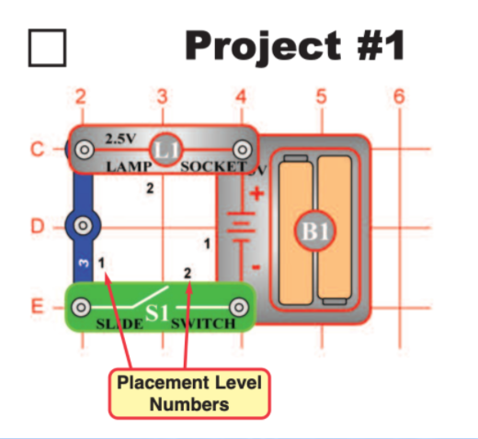
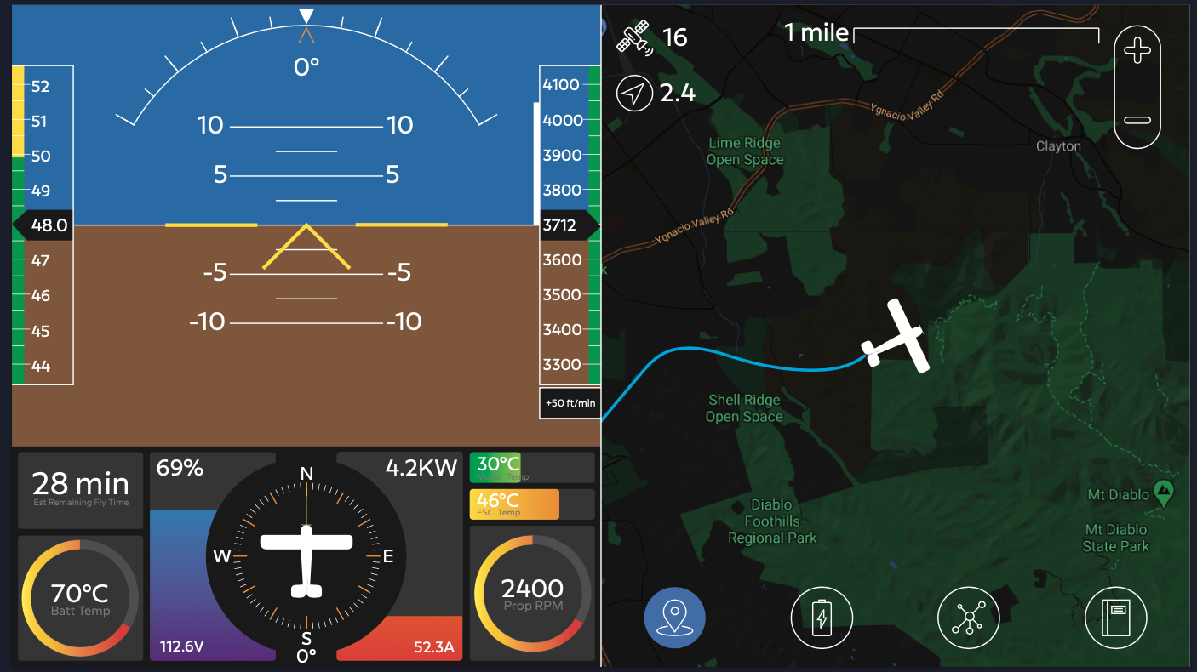
Goals for the Course: Electrical
Understand the basic electric concepts and get hands on experience
Snap Circuits
Voltage, Resistance, Current
Why? Well-rounded engineer
Notes:
maya

Slide 18
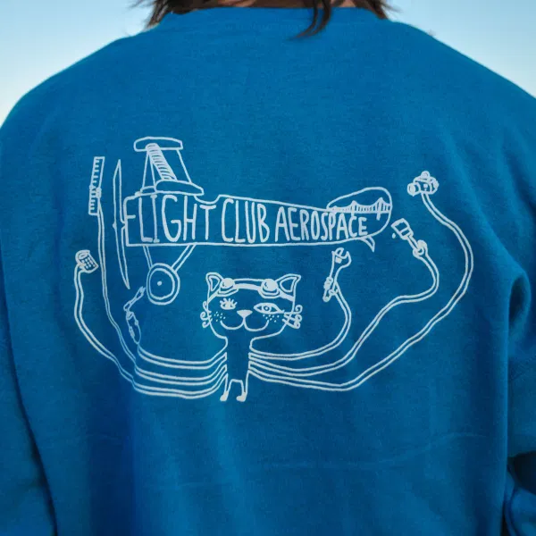
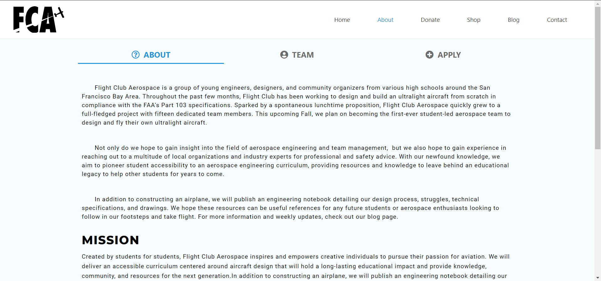
Goals for the Course: Marketing + Outreach
Market their designed plane
Build a website using google sites
Why? Communication, building a person not just engineer
Notes:
Agastya: Marketing plays a very important role in FCA. Your students will learn how to communicate with outside sources, build their own website, and market their own creations to ensure they are well rounded and learn necessary communication skills in order to grow into fully fledged independent people, not just engineers.

Slide 19
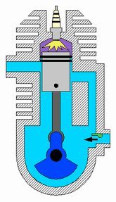
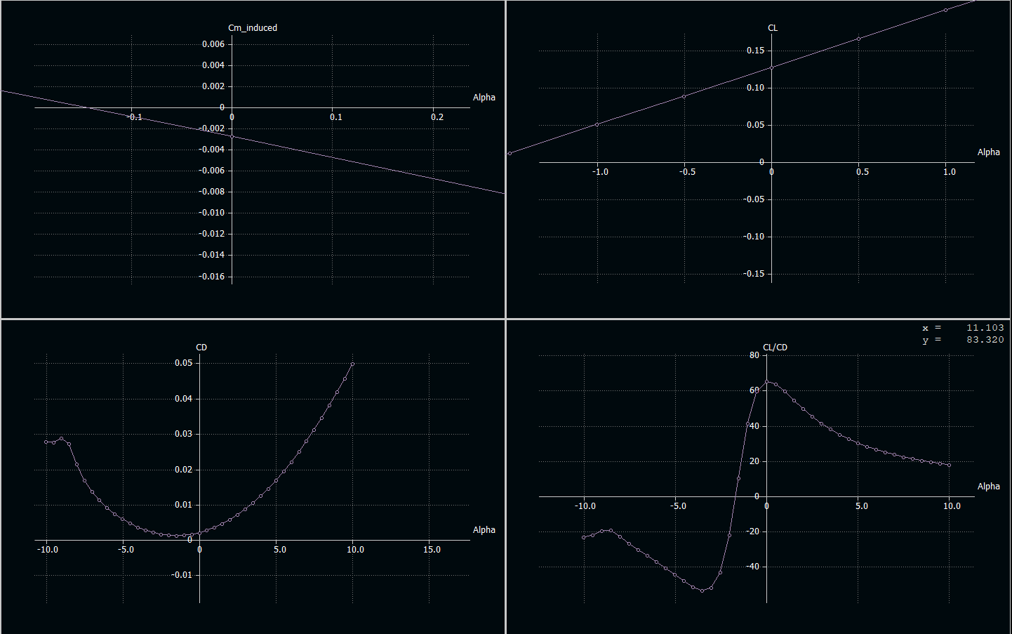
Goals for the Course: Industry Opportunities
Find and explore future possibilities in aerospace and engineering
Options:
Understand more physics
Discover + research other plane parts
Build CAD skills
Why? Synthesis of the whole camp. How to apply their skills universally
Notes:
Jasmine

Slide 20
Logistics
Requirement: a laptop: zoom + Onshape
Chromebook is good but if there are other devices available that’s preferred
Website: flightclubaerospace.com/SummerCamp
Recordings + Curriculum available
If missing a class: watch + follow along with the activities → send an email to general@flightclubaerospace.com if you have questions
5-6 pm Tuesdays & Thursdays at bit.ly/FCAzoom
Send us your addresses for the kits here
Notes:
Harish

Slide 21
Questions?
Notes:
Harish

Slide 22

Signing up for Onshape - We’ll learn more about this in proceeding classes!
Go here! - https://www.onshape.com/en/education/#form-container
Create an account and go through the steps (anyone willing to screen share to show us?)
Send us all your emails here (so we can add you to the team)!! https://forms.gle/G5feXKMFnmrUggUN8
Let us know if you have any questions/problems! (This will happen frequently, so don’t worry too much if you’re having trouble)
Notes:
Alex and Maya

Slide 23
Thank you!
Feedback Form
Notes:
Harish

